Slide 1
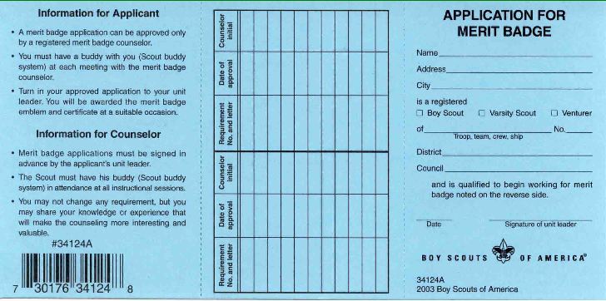
This section to be completed if requirements finished at different times.
Initials by one counselor may help completion by another counselor.
#1 Read this
#2 Print Scout Name,
Address, and Info
X
Troop 109
Redwood
Pacific Skyline
#3 Scoutmaster signs/dates here before
presenting to merit badge counselor

Slide 2
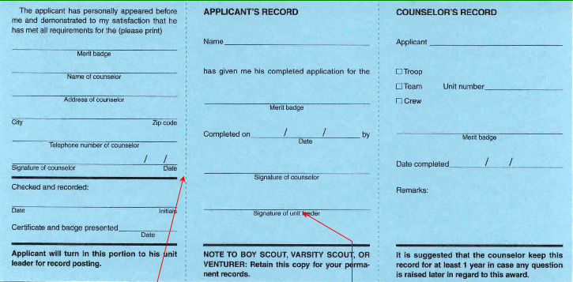
#4 Enter merit badge name,
name and address of counselor
Scout keeps this portion
Counselor keeps this portion
Print Scout Name
Print Scout Name
Enter merit badge name
X
109
Enter merit badge name
Enter merit badge name
#5 Counselor signs in 2 places, dates in
3 places once merit badge completed
#6 Scoutmaster provides
final signature and date recorded

